Slide 1
Geography and history game
By Blue birds

Slide 2
TABLE OF CONTENTS
OUR TEAM
STAGES OF REALISATION
USED TECHNOLOGIES

Slide 3

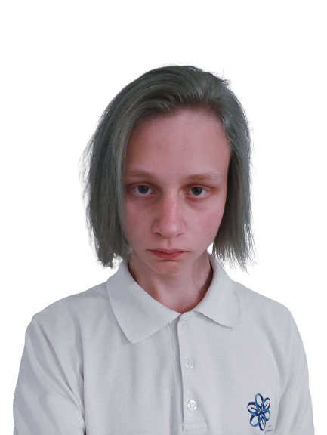
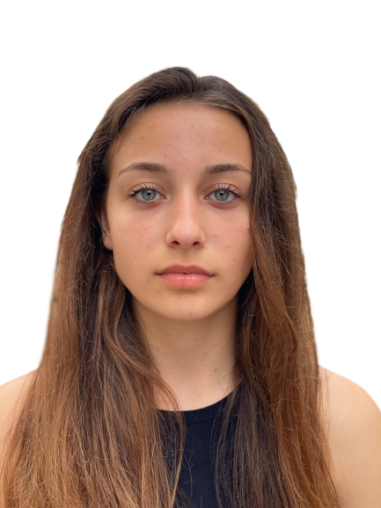
OUR TEAM
LORENA HRISTOVA
RAYA MAVRAGANOVA
STEPAN
URIVKO
SCRUM
TRAINER
BACKEND
BACKEND
QA

Slide 4
STAGES OF REALISATION
1. Design the game
2. Backend
3. QA
4. Presentation and documentation
Design
Backend
QA
P&D

Slide 5





USED TECHNOLOGIES
Visual studio
GitHub
Word
Power point
Teams

Slide 6
Now, let’s see the game

